Slide 1
Introduction
to
Microsoft word 2010

Slide 2
Editing Documents in word 2010

Slide 3
Objectives Overview
How to insert text in word
How to select text in word
How to delete text in word
How to move text in word
How to copy & paste in word
How to find & replace in word

Slide 4
Objectives Overview
How to spell Check in word
How to Zoom In-Out in word
How to insert Special symbols
How to Undo and Redo changes in word
How to use Context Help in word

Slide 5
Insert Text in Word 2010
Microsoft Word provides two(2) ways to insert text in existing text. They are
Insert and Add Text
Insert and Replace Text

Slide 6
Insert and Add Text
Step 1
To begin with, let us create some sample text.
To create a sample text, there is a short cut available.
Open a new document and type =rand() and press Enter.

Slide 7
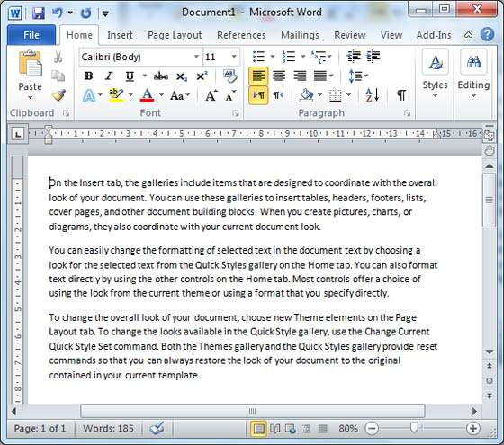
Insert and Add Text
Word will create the following content for you.

Slide 8
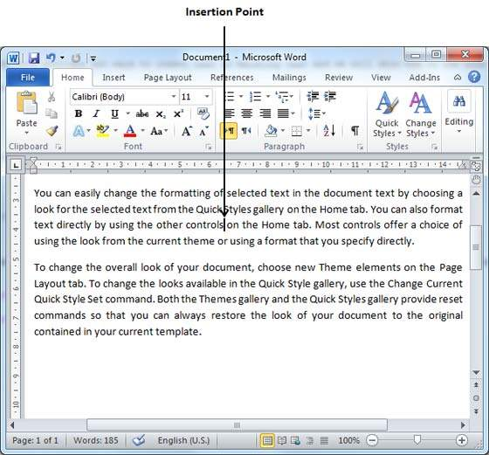
Insert and Add Text
Step 2
Click the location where you wish to insert text;
you can also use the keyboard arrows to locate the place where the text needs to be inserted.

Slide 9
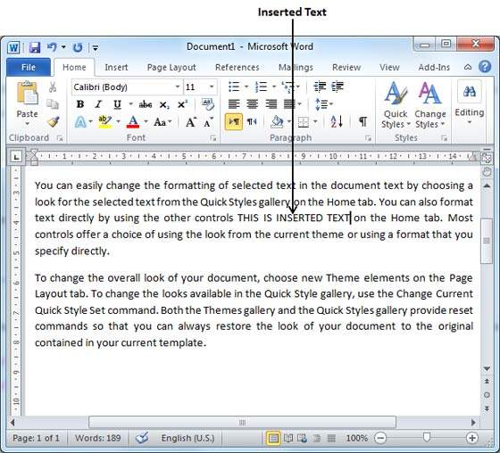
Insert and Add Text
Step 3
Start typing the text that needs to be inserted.
Word inserts the text to the left of the insertion point, moving the existing text to the right.

Slide 10
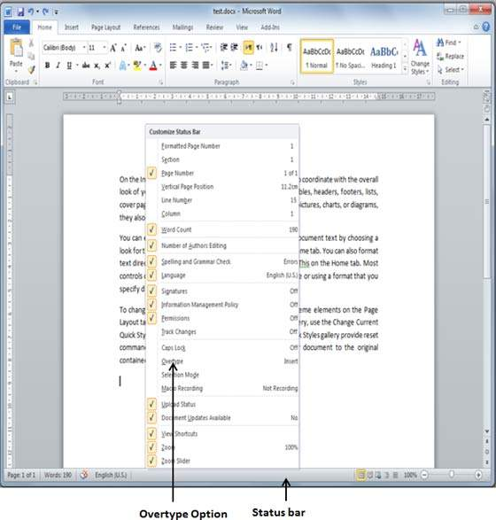
Insert and Replace Text
Step 1
Right-click the status bar
select the Overtype option from the displayed menu.

Slide 11
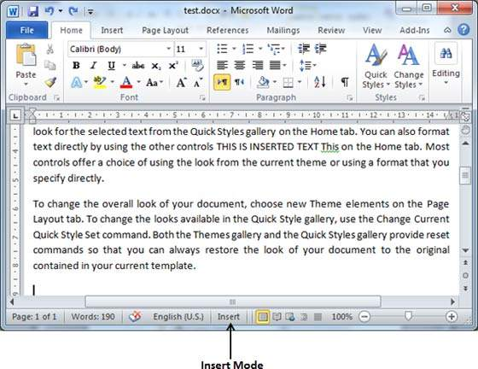
Insert and Replace Text
Step 1
When you select the Overtype option, the status bar will show the insert mode as shown below.

Slide 12
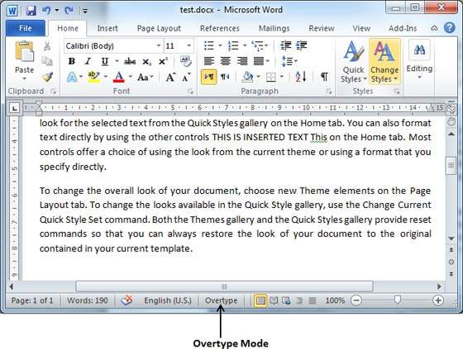
Insert and Replace Text
Step 2
Click on the Insert text available at the status bar and it will switch to the Overtype mode as shown below.

Slide 13
Insert and Replace Text
Step 3
Now click the location where the text needs to be inserted or you can use the keyboard arrows to locate the place where the text needs to be inserted.

Slide 14
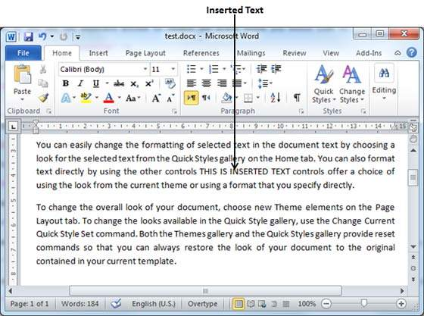
Insert and Replace Text
Step 4
Start typing the text that needs to be inserted.
Word will replace the existing text with the newly typed text without moving the position of the exiting test.

Slide 15
Select Text in Word 2010
Selecting a text is one of the most important skills required while editing a word document.
You can perform various operations on a selected text; you can delete the selected text, copy it, move it, apply formatting to it, change its capitalization, etc.

Slide 16
Select Text in Word 2010
The most common method of selecting a text is to click and drag the mouse over the text you want to select.
The following table lists down a few other simple methods that will help you in selecting text in different scenarios −

Slide 17
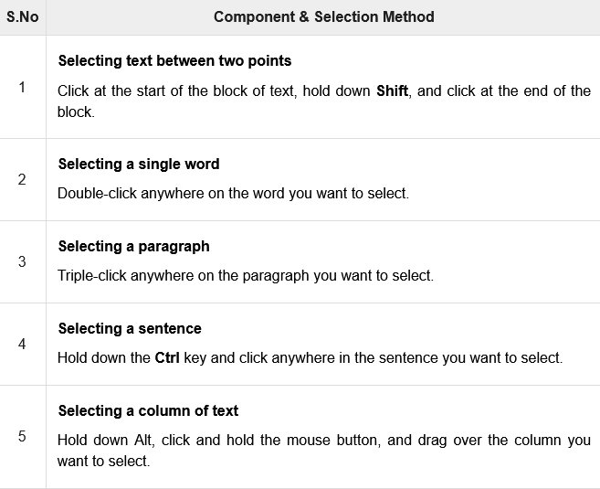
Select Text in Word 2010

Slide 18
Select Text in Word 2010
NOTE
Note that only one part of the document can be in the selected state.
If you have one portion of the document in selected state and as soon as you try to select any other part of the document, previous part will automatically be de-selected.

Slide 19
Select Text Using the Keyboard
Keyboard provides very good support when you want to select various components of the document as described in the following table

Slide 20
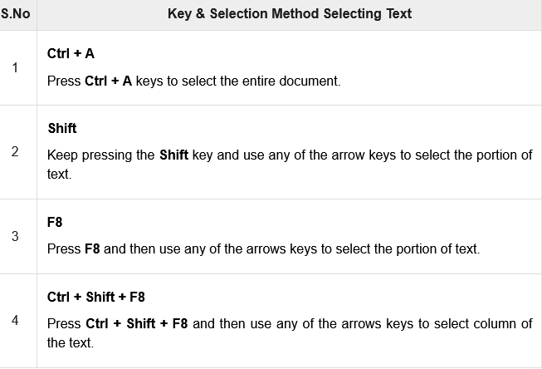
Select Text Using the Keyboard

Slide 21
Delete Text in Word 2010
It is very common to delete text and retype the content in your Word document.
You might type something you did not want to type or there is something extra which is not required in the document.
Regardless of the reason, Word offers you various ways of deleting the text in partial or complete content of the document.

Slide 22
Using Backspace & Delete Keys
The most basic deletion technique is to delete characters one at a time by pressing either the backspace key or the delete key.
The following table describes how you can delete single character or a whole word by using either of these two keys

Slide 23
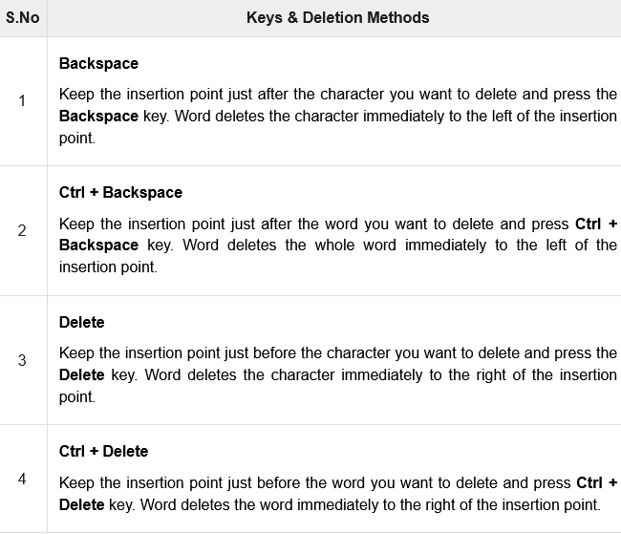
Using Backspace & Delete Keys

Slide 24
Using Selection Method
You have learnt how to select various parts of a Word document.
You can make use of that learning to delete those selected parts as described in the following table

Slide 25
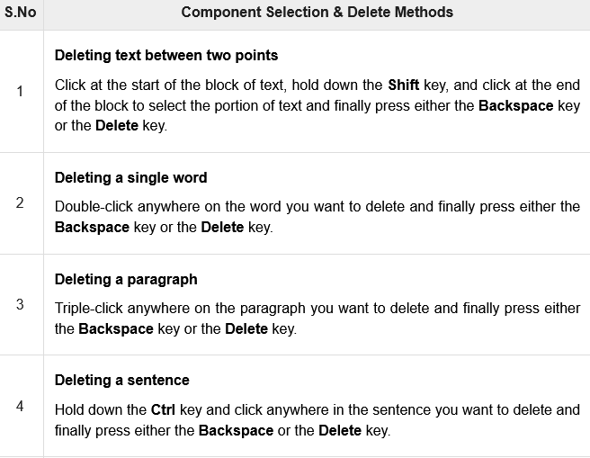
Using Selection Method

Slide 26
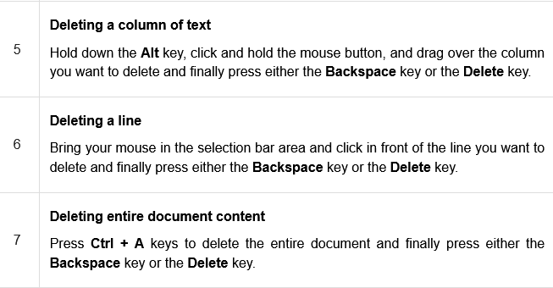
Using Selection Method

Slide 27
Move Text in Word 2010
You can move text from one location in a document to another by using the drag-and-drop technique with the help of mouse.
This tutorial will teach you how to use the drag and drop technique to move text.

Slide 28
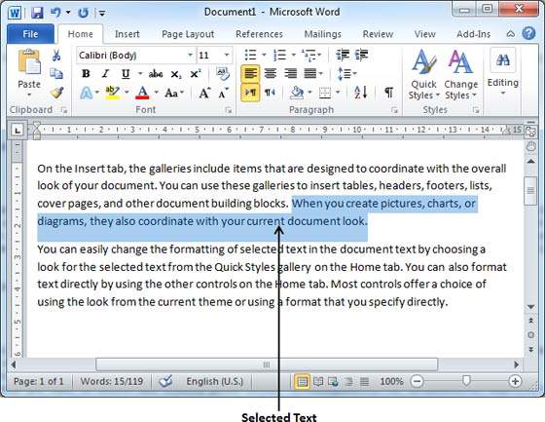
Move within the same document
Step 1
Select a portion of the text using any of the text selection methods.

Slide 29
Move within the same document
Step 2
Now take your mouse pointer over the selected text and hold the left button of the mouse and keep holding it while moving around the document.

Slide 30
Move within the same document
Step 3
Take your mouse pointer to the place where you want to move the selected text and release the mouse button.
You will see that the selected text is moved to the desired location.

Slide 31
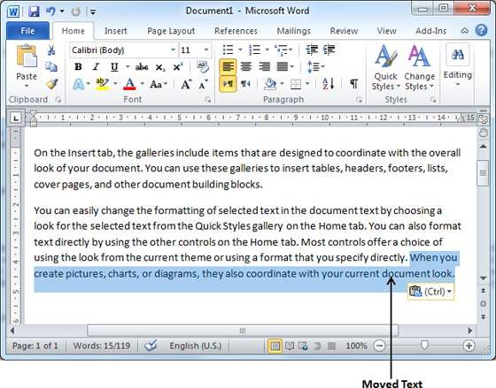
Move within the same document
Step 3

Slide 32
Move within different documents
Step 1
Open a new word document

Slide 33
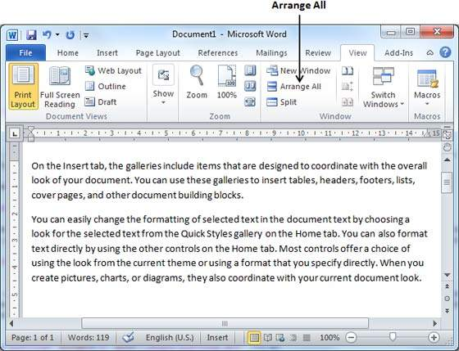
Move within different documents
Step 2
Keep both the documents opened and to ensure that both documents are visible, click the Arrange All button on the View tab on the Ribbon.

Slide 34
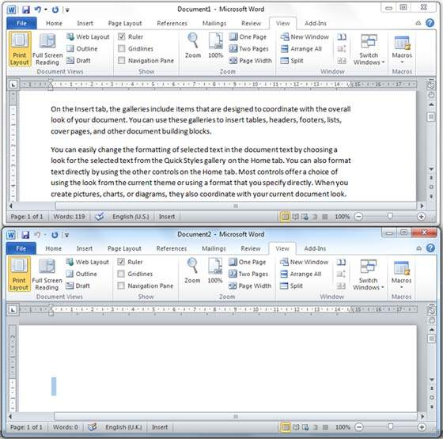
Move within different documents
Step 2
This will display both the documents as shown below

Slide 35
Move within different documents
Step 3
Now, select a portion of the text using any of the text selection methods.
Step 4
Take your mouse pointer over the selected text and hold the left button of the mouse and keep holding it while moving around the document.

Slide 36
Move within different documents
Step 5
Take your mouse pointer at the place in the second document where you want to move the selected text and release the mouse button.
You will see that the selected text is moved to the desired location in the second document.

Slide 37
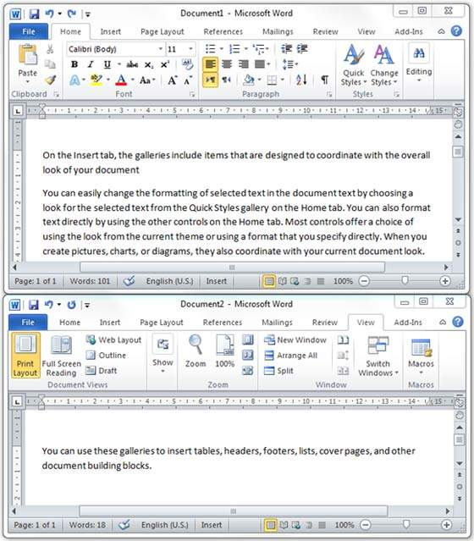
Move within different documents
Step 5

Slide 38
Copy & Paste in Word 2010
To use copy and paste or cut and paste operations, Word makes use of a temporary memory which is called the clipboard.
When you copy or cut a text, it stay on the clipboard temporarily and in the second step you can paste this content at the desired location.

Slide 39
Copy & Paste Operation
The Copy operation will just copy the content from its original place and create a duplicate copy of the content at the desired location without deleting the text from it's the original location.
The Following is the procedure to copy the content in word

Slide 40
Copy & Paste Operation
Step 1
Select a portion of the text using any of the text selection methods.

Slide 41
Copy & Paste Operation
Step 2
You have various options available to copy the selected text in clipboard.
You can make use of any one of the options −
  Using Right-Click: When you right-click on the selected text, it will display the copy option, click this option to copy the selected content in clipboard.
  Using Ribbon Copy Button: After selecting text, you can use the copy button available at the ribbon to copy the selected content in clipboard.
  Using Ctrl + c Keys: After selecting a text, just press Ctrl + c keys to copy the selected content in clipboard.

Slide 42
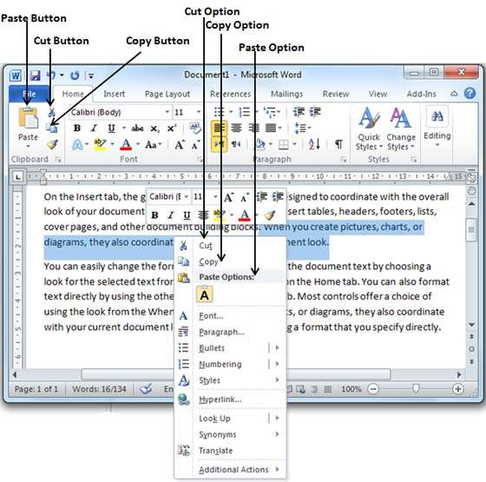
Copy & Paste Operation
Step 2

Slide 43
Copy & Paste Operation
Step 3
Finally click at the place where you want to copy the selected text and use either of these two simple options
  Using Ribbon Paste Button: Just click the Paste button available at the ribbon to paste the copied content at the desired location.
  Using Ctrl + v Keys − This is simplest way of pasting the content. Just press Ctrl + v keys to paste the content at the new location.

Slide 44
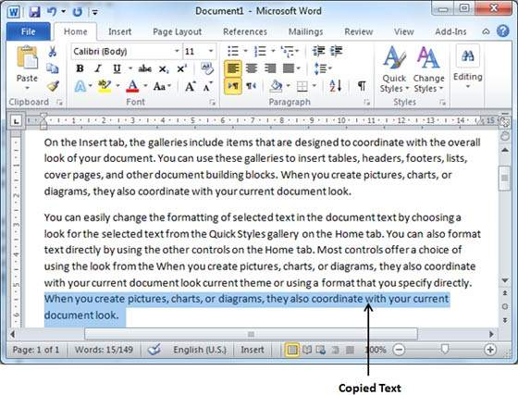
Copy & Paste Operation
Step 3
Note − You can repeat the Paste operation as many times as you like to paste the same content.

Slide 45
Cut & Paste Operation
The Cut operation will cut the content from its original place and move the content from its original location to a new desired location.
The Following is the procedure to cut & paste the content in word

Slide 46
Cut & Paste Operation
Step 1
Select a portion of the text using any of the text selection methods.

Slide 47
Cut & Paste Operation
Step 2
Select a portion of the text using any of the text selection methods.
Now, you have various options available to cut the selected text and put it in the clipboard.
You can make use of one of these options

Slide 48
Cut & Paste Operation
Step 2
Using Right-Click: If right-click on the selected portion of text, it will display cut option, just click this option to cut the selected content and keep it in clipboard.
Using Ribbon Cut Button: After selecting a portion of text, you can use cut button available at the ribbon to cut the selected content and keep it in clipboard.
Using Ctrl + x Keys: After selecting a portion of text, just press Ctrl + x keys to cut the selected content and keep it in clipboard.

Slide 49
Cut & Paste Operation
Step 2

Slide 50
Cut & Paste Operation
Step 3
Finally, click at the place where you want to move the selected text and use either of these two simple options:
  Using Ribbon Paste Button − Just click the Paste button available at the ribbon to paste the content at the new location.
  Using Ctrl + v Keys − This is simplest way of pasting the content. Just press Ctrl + v keys to paste the content at the new location.

Slide 51
Cut & Paste Operation
Step 3
Note − You can repeat the Paste operation as many times as you like to paste the same content.

Slide 52
Copy, Cut & Paste in different documents
You can use the same procedure that we discussed above to copy and paste or cut and paste content from one document to another document.
just copy or cut the desired content from one document and go into another document where you want to paste the content and use mentioned step to paste the content.
You can use the Alt + Tab keys to switch through the different documents and select the desired destination document.

Slide 53
Find & Replace in Word 2010
While working on editing a document you come across a situation very frequently when you want to search a particular word in your document.
Many times you will be willing to replace this word with another word at a few or all the places throughout the document.

Slide 54
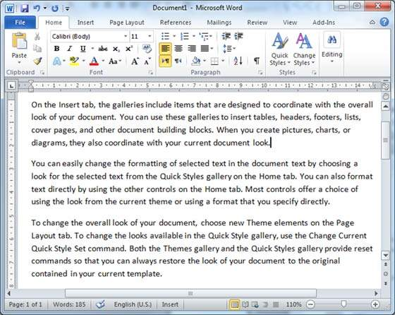
Find Command
Step 1
Type =rand() and press Enter; the following screen will appear.

Slide 55
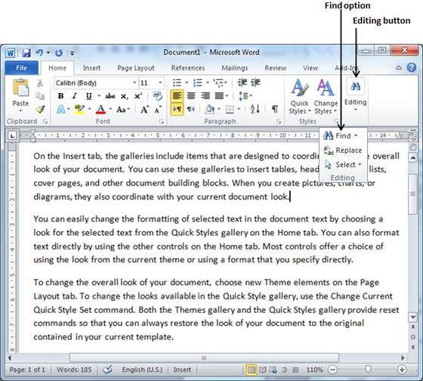
Find Command
Step 2
Click the Find option in the Editing group on the Home tab or press Ctrl + F to launch the Navigation pane.

Slide 56
Find Command
Step 3
Enter a word which you want to search in the Search box
Word searches for the text you entered and displays the results in the navigation pane.
and highlights the word in the document as in the following screenshot

Slide 57
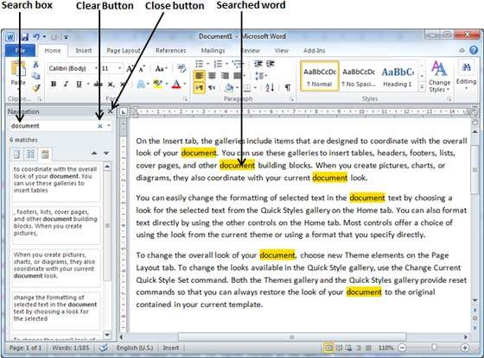
Find Command
Step 3

Slide 58
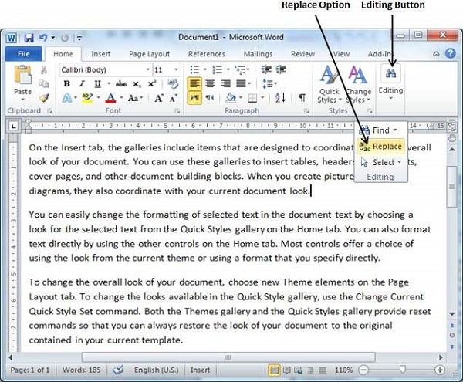
Find & Replace Operation
Step 1
Click the Replace option in the Editing group on the Home tab or
press Ctrl + H to launch the Find and Replace dialog box shown.

Slide 59
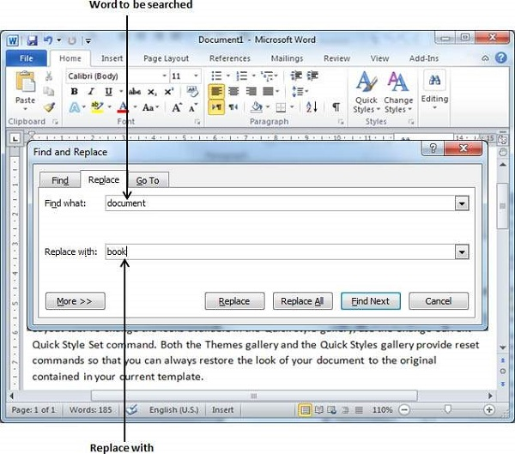
Find & Replace Operation
Step 2
Type a word which you want to search.
You can also replace the word using the Find and Replace dialog box as in the following screenshot.

Slide 60
Find & Replace Operation
Step 3
Click the Replace button available on the Find and Replace dialog box and you will see the first occurrence of the searched word would be replaced with the replace with word.
Clicking again on Replace button would replace next occurrence of the searched word.
If you will click Replace All button then it would replace all the found words in one go

Slide 61
Spell Check in Word 2010
Microsoft Word provides a decent Spelling and Grammar Checker which enables you to search for and correct all spelling and grammar mistakes in your document.
Word is intelligent enough to identify misspelled or misused, as well as grammar errors and underlines them as follows.
  A red underline beneath spelling errors.
  A green underline beneath grammar errors.
  A blue line under correctly spelled but misused words.

Slide 62
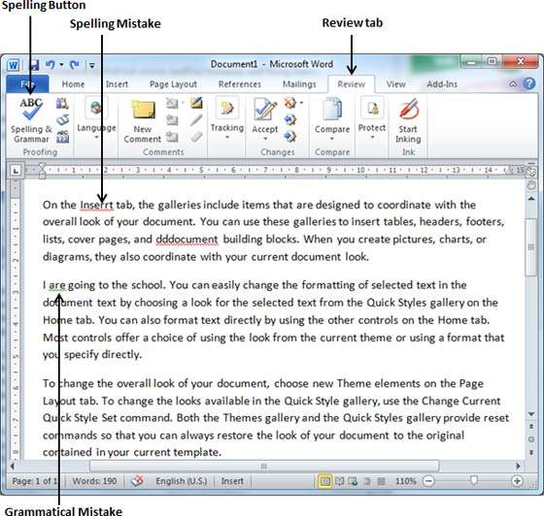
Check Spelling and Grammar using Review tab
Step 1
Click the Review tab and then click the Spelling & Grammar button.

Slide 63
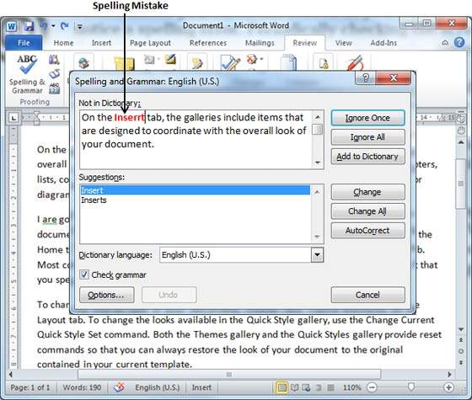
Check Spelling and Grammar using Review tab
Step 2
A Spelling and Grammar dialog box will appear and will display the wrong spellings or errors in grammar.

Slide 64
Check Spelling and Grammar using Review tab
Step 2
Now you have following options to fix the spelling mistakes
  Ignore: If you are willing to ignore a word, then click this button and Word ignores the word throughout the document.
  Ignore All: Like Ignore, but this ignores all occurrences of the same misspelling, not just once but throughout the document.
  Add to Dictionary: Choose Add to Dictionary to add the word to the Word spelling dictionary.

Slide 65
Check Spelling and Grammar using Review tab
Step 2
Now you have following options to fix the spelling mistakes
  Change: This will change the wrong word using the suggested correct word.
  Change All: Like Change, but this changes all occurrences of the same misspelling, not just once but throughout the document.
  AutoCorrect: If you select a suggestion, Word creates an AutoCorrect entry that automatically corrects this spelling error from now on.

Slide 66
Check Spelling and Grammar using Review tab
Step 2
The following are the different options in case you have grammatical mistake
  Next Sentence: You can click Next Sentence to direct the grammar checker to skip ahead to the next sentence.
  Explain: The grammar checker displays a description of the rule that caused the sentence to be flagged as a possible error.
  Options: This will open the Word Options dialog box to allow you to change the behavior of the grammar checker or spelling options.
  Undo: This will undo the last grammar changed.

Slide 67
Check Spelling and Grammar using Review tab
Step 3
Select one of the given suggestions you want to use and click the Change option to fix the spelling or grammar mistake and repeat the step to fix all the spelling or grammar mistake.

Slide 68
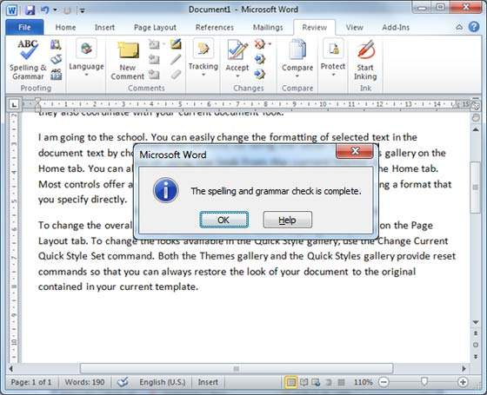
Check Spelling and Grammar using Review tab
Step 4
Word displays a dialog box when it finishes checking for spelling and grammar mistakes, finally Click OK.

Slide 69
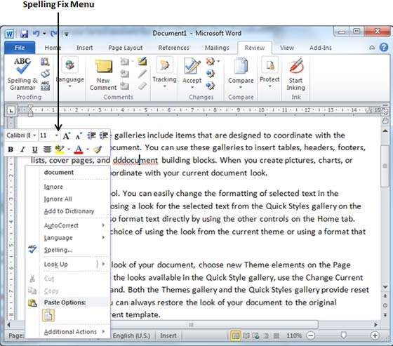
Check Spelling and Grammar using Right Click
If you will right-click the mouse button over a misspelled word, then it will show you the correct suggestions and the above mentioned options to fix the spelling or grammar mistake.

Slide 70
Zoom In-Out in Word 2010
Microsoft Word provides a functionality to apply zoom-in and zoom-out operations on a document.
When we apply the zoom-in operation, it enlarges the size of text whereas applying the zoom-out operation reduces the size of text.
A zoom operation just changes the size of the font on-screen without impacting any other attribute of the document.

Slide 71
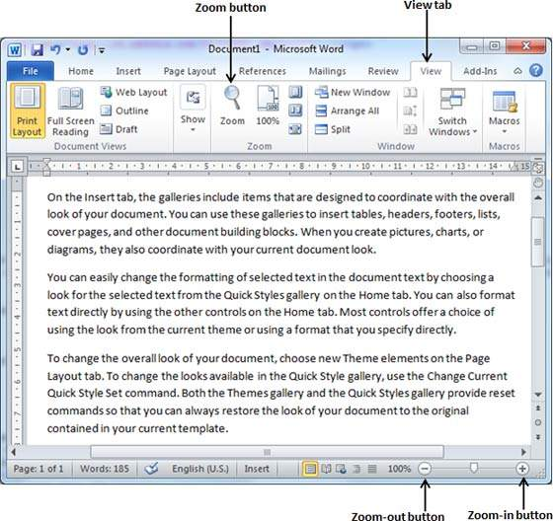
Zoom-in & Zoom-out using view tab
Step 1
Click the View tab and then click the Zoom button as shown below.

Slide 72
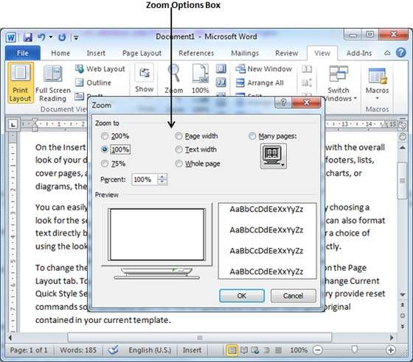
Zoom-in & Zoom-out using view tab
Step 2
When you click the Zoom button, a Zoom dialog box will appear as shown below.

Slide 73
Zoom-in & Zoom-out using view tab
Step 2
This will display the zoom options box to select a value to reduce or increase the size of the document on-screen.
By default, it will be 100%; you can select 200% to increase the size of the font or 75% to reduce the size of the font.
Step 3
Once you are done with selecting an option, click OK to apply the changes on the document.

Slide 74
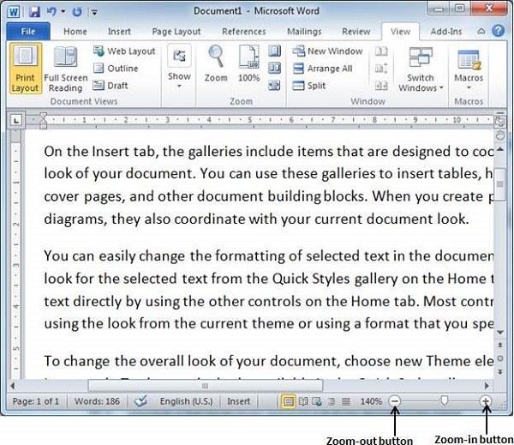
Zoom-in & Zoom-out using (+) and (-) Buttons
The following screenshot shows two buttons Zoom-out which is the (-) button and Zoom-in which is the (+) button.

Slide 75
Zoom-in & Zoom-out using (+) and (-) Buttons
Step 1
Click the Zoom-out button, you will find that your document size will decrease by 10% each time you click the button.
Similar way, if you click on Zoom-in button your document size will increase by 10% each time you click the button.
Try this simple operation with different values to see the difference. The above screenshot shows 140% zoom-in view of the document.

Slide 76
Special Symbols in Word 2010
Your keyboard may not have many characters available but you want to use those characters in your document; in such situations, you have the option to insert Special Symbols.
If you find yourself using a particular symbol frequently, you can assign a keyboard shortcut to it.

Slide 77
Insert Special Symbols
Step 1
To insert a special symbol, bring your cursor at the place where you want to insert the symbol.
Click the Insert tab. You will find two options under the symbol button (a) Equation and (b) Symbols.
For now, we are going to understand the use of the Symbol button as shown below.

Slide 78
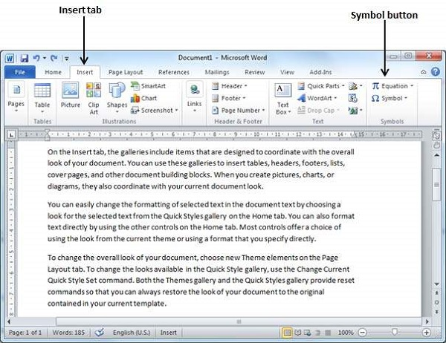
Insert Special Symbols
Step 1

Slide 79
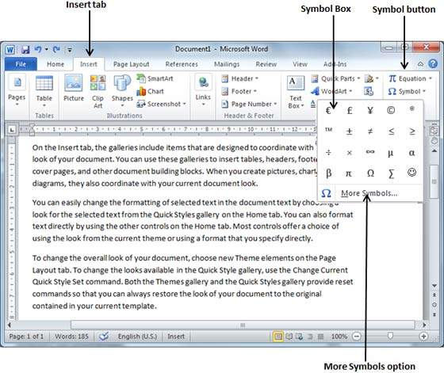
Insert Special Symbols
Step 2
When you click the Symbol button, a small list of symbols will appear as shown below.

Slide 80
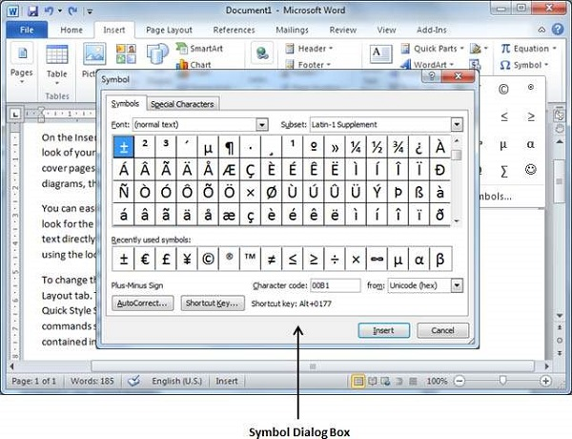
Insert Special Symbols
Step 3
If you do not find the desired symbol in this small box, then you can click at the More Symbols option to have a wide range of symbols as shown below in the symbol dialog box.

Slide 81
Assign Shortcut Key
You can assign a keyboard shortcut to type any of the available symbol.
The following are the steps to assign Ctrl + Q key to insert the © symbol which is one of the available symbols in the special symbols list.

Slide 82
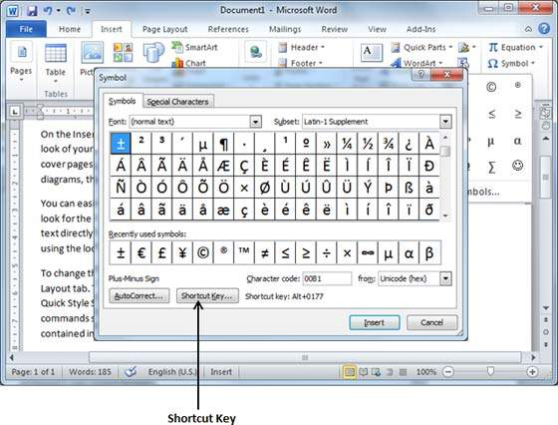
Assign Shortcut Key
Step 1
Assume you already have the following symbol dialog box opened.

Slide 83
Assign Shortcut Key
Step 2
Click the symbol for which a shortcut key needs to be assigned.
Now click Shortcut Key button which will display the following Customize Keyboard dialog box.

Slide 84
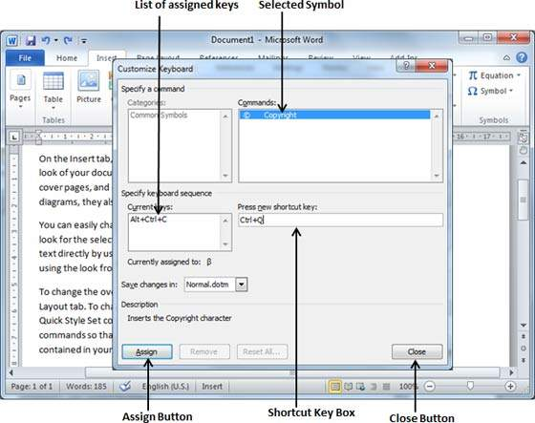
Assign Shortcut Key
Step 2

Slide 85
Assign Shortcut Key
Step 3
Now type the selected shortcut key in the shortcut key box.
You press Ctrl + Q and then click the Assign button to assign the shortcut key.
Finally, use the Close button to close the dialog box.
Now try to type Ctrl + Q using the keyboard directly and you will find that you are able to type © symbol without going into the symbol dialog box.

Slide 86
Undo Changes in Word 2010
Microsoft word provides two important features called the Undo and the Repeat or Redo.
The Undo feature is used to undo the previous action and the Repeat or Redo feature is used to repeat the previous action.
For example, if you mistakenly delete text, you can use the Undo feature to recover it.
In a similar way, if you delete a character and you want to delete more characters then you can use the Repeat operation.

Slide 87
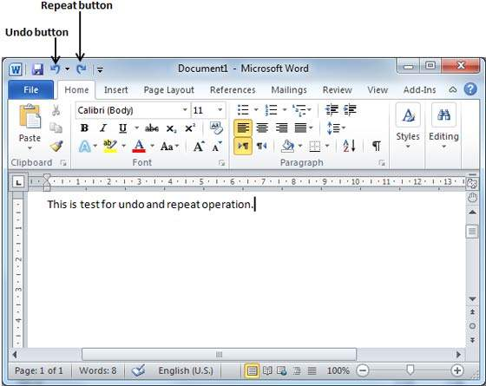
How to use Undo & Repeat operations
You can access the Undo and Repeat buttons from the Quick Access toolbar.
You should make a note that the Repeat button is also called Redo button and both the operations have the same meaning.

Slide 88
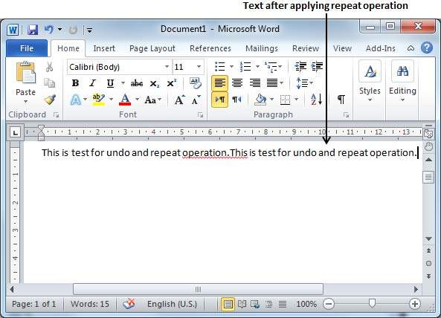
How to use Undo & Repeat operations
Step 1
Let us type some text in a blank document. Now click the Repeat (Redo) button and you will see that Word will repeat the same operation for you.

Slide 89
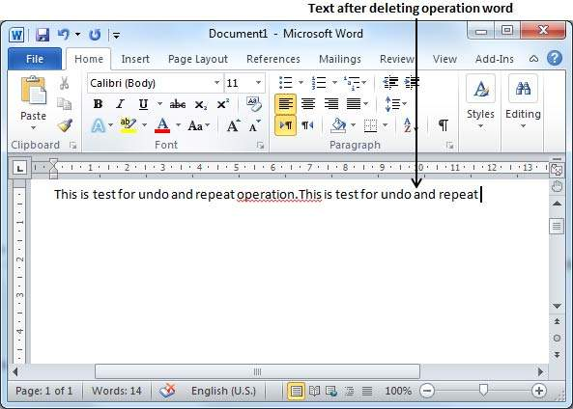
How to use Undo & Repeat operations
Step 2
Now to examine the undo operation, let us delete the last word operation character by character so that you have the following text remaining in the line.

Slide 90
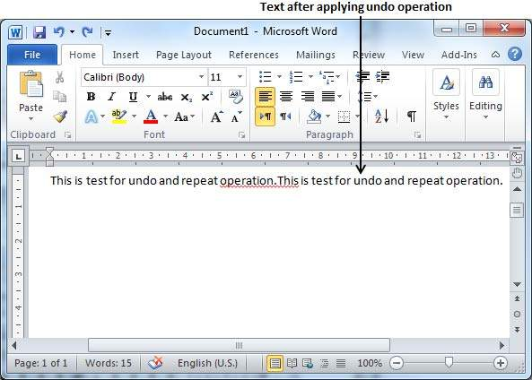
How to use Undo & Repeat operations
Step 3
Let us try to click the Undo button one by one. You will see that Word will recover all the deleted characters one by one after performing a few undo operations.

Slide 91
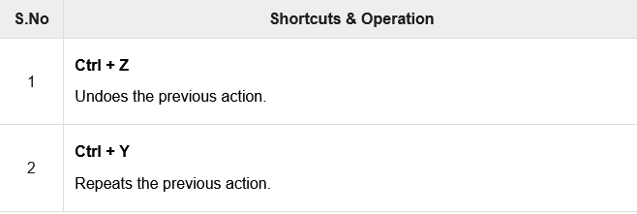
Shortcuts to use Undo & Repeat operations

Slide 92


Slide 93
THANK YOU

